Slide 1

AI INTERVIEW VOICE ASSISTANT
PRESENTATION BY
VELMURUGAN V (Reg No: 24PMC147) SOMESHWAR K ( Reg. No.:24PMC126)
ZISHAAN ATHEEQ MOHAMMED
(Reg No: 24PMC158)
guide BY
Dr. T. AMALRAJ VICTOIRE
Associate Professor, Department of MCA

Slide 2
AGENDA
Abstract
Existing system
Proposed system
Software & Hardware requirement
Modules
Architectural Diagram
Use Case Diagram
Sequence Diagram
Conclusion
Screenshots

Slide 3
ABSTRACT
The AI Interview Voice Assistant is an intelligent platform designed to simulate real-time job interviews.
It leverages speech recognition to capture user responses, text-to-speech for delivering interview questions, and natural language processing to evaluate answers. The system provides instant feedback, detailed reports on communication skills, clarity, confidence, and technical depth.
This AI-powered system offers scalability, accessibility, and personalized insights to help candidates improve their interview performance.

Slide 4
Existing System
Mock interviews conducted manually by HR professionals or peers.
Limited availability of trained evaluators.
Time-consuming process with delayed feedback.
Lack of personalized, data-driven insights.
Accessibility restricted to physical or scheduled sessions.

Slide 5
Proposed System
Automated AI-based interview assistant.
Voice interaction with real-time question delivery.
Automated recording and transcription of answers.
Real-time evaluation of communication, technical depth, and clarity.
Instant feedback and comprehensive performance reports.
Available anytime, anywhere through a web-based platform.

Slide 6
Software & Hardware requirement
Software requirement
Frontend: React, TypeScript, CSS3
Backend: Express JS
API : OpenAI, Gemini API
Database: Mongo DB

Slide 7
Hardware requirement
Hardware requirement
Processor: Intel i3 or higher
RAM: Minimum 4 GB
Hard Disk: Minimum 250 GB

Slide 8
Modules
1. Authentication Module – Login/Register for users.
2. Speech-to-Text Module – Converts user responses into text.
3. Text-to-Speech Module – Reads out interview questions.
4. API Call – Evaluates clarity, confidence, technical knowledge.
5. Feedback Module – Provides real-time suggestions and scoring.
6. Report Generation Module – Summarizes performance with strengths,
weaknesses, and recommendations.

Slide 9
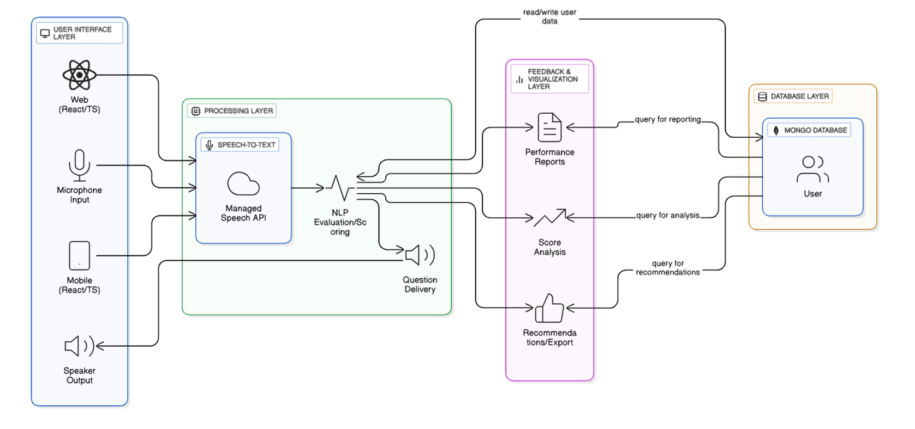
Architectural Diagram

Slide 10
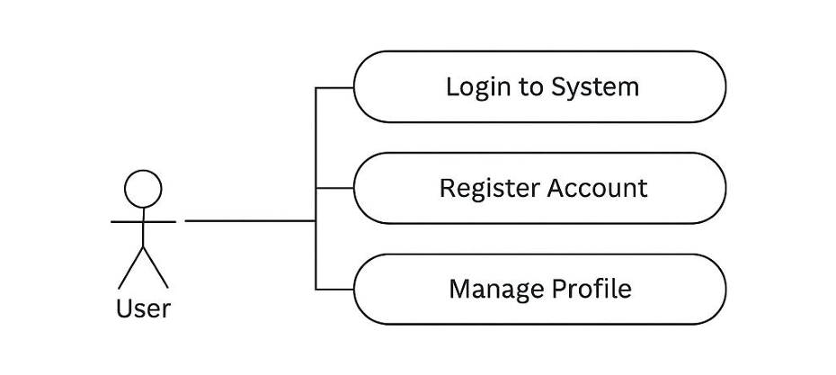
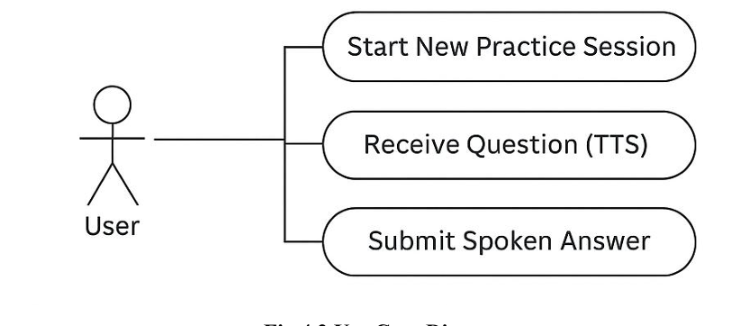
Use Case Diagram

Slide 11
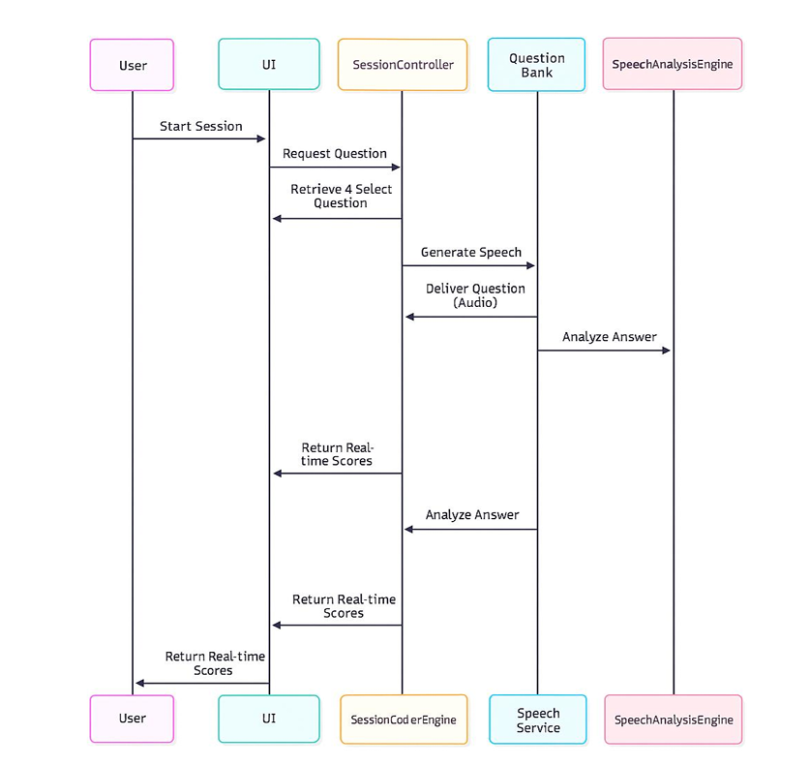
SEQUENCE DIAGRAM

Slide 12
CONCLUSION
The Interview Voice Assistant project successfully delivered an innovative, voice driven platform for automated interview preparation.
This combination provides job seekers with an objective, data-driven assessment crucial for improving performance.

Slide 13
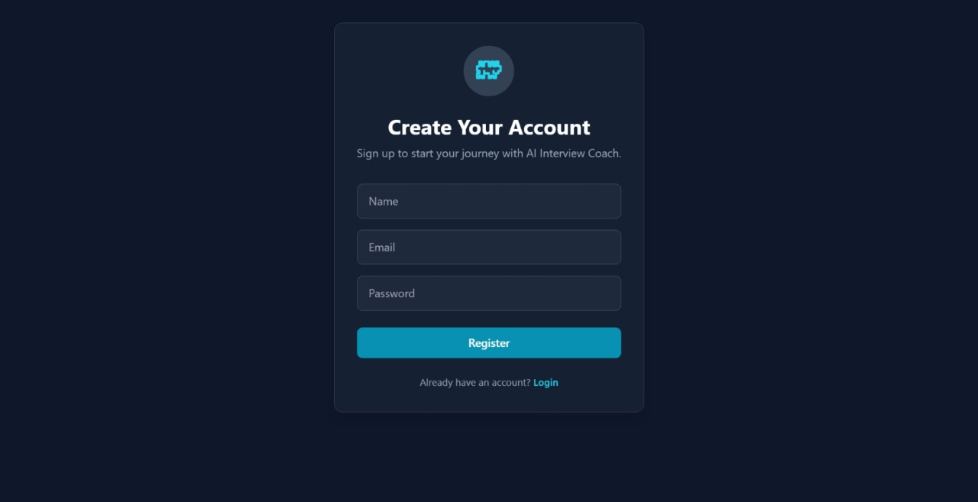
Screenshots

Slide 14
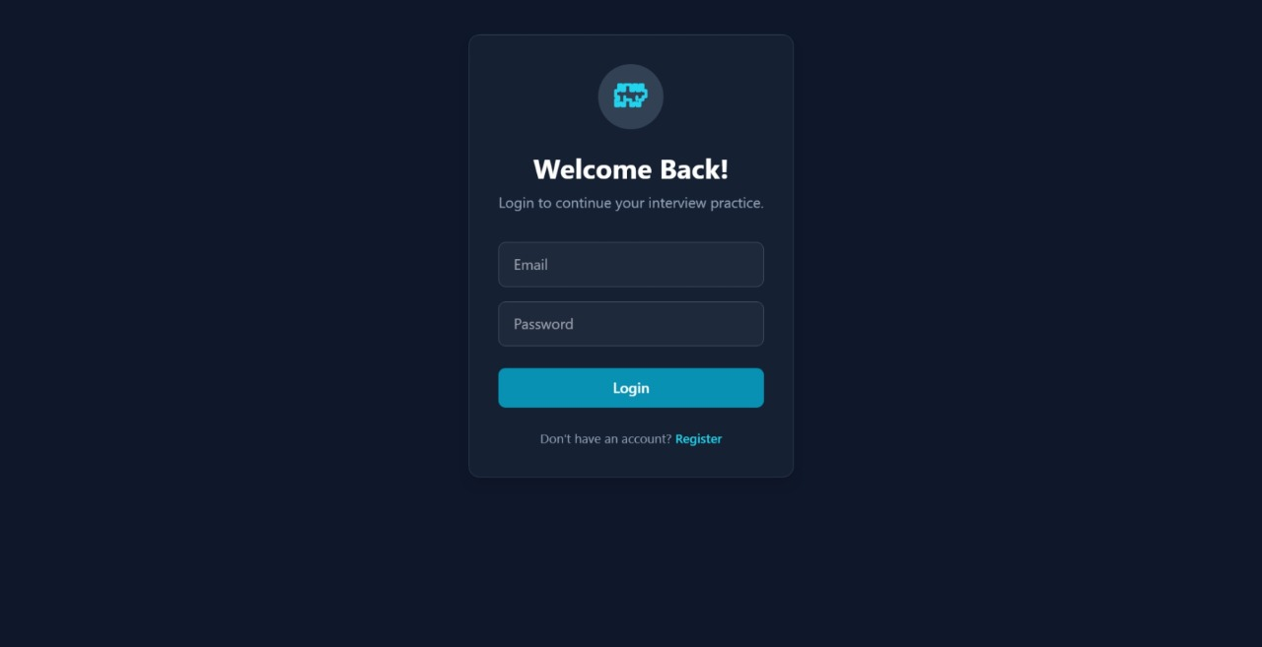
LOGIN PAGE

Slide 15
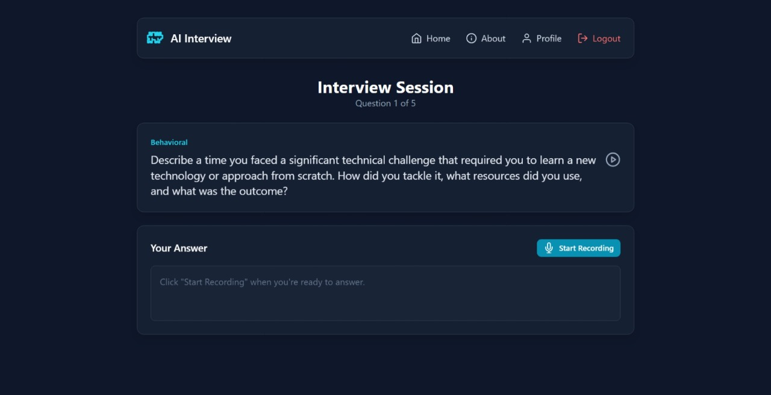
HOME PAGE

Slide 16
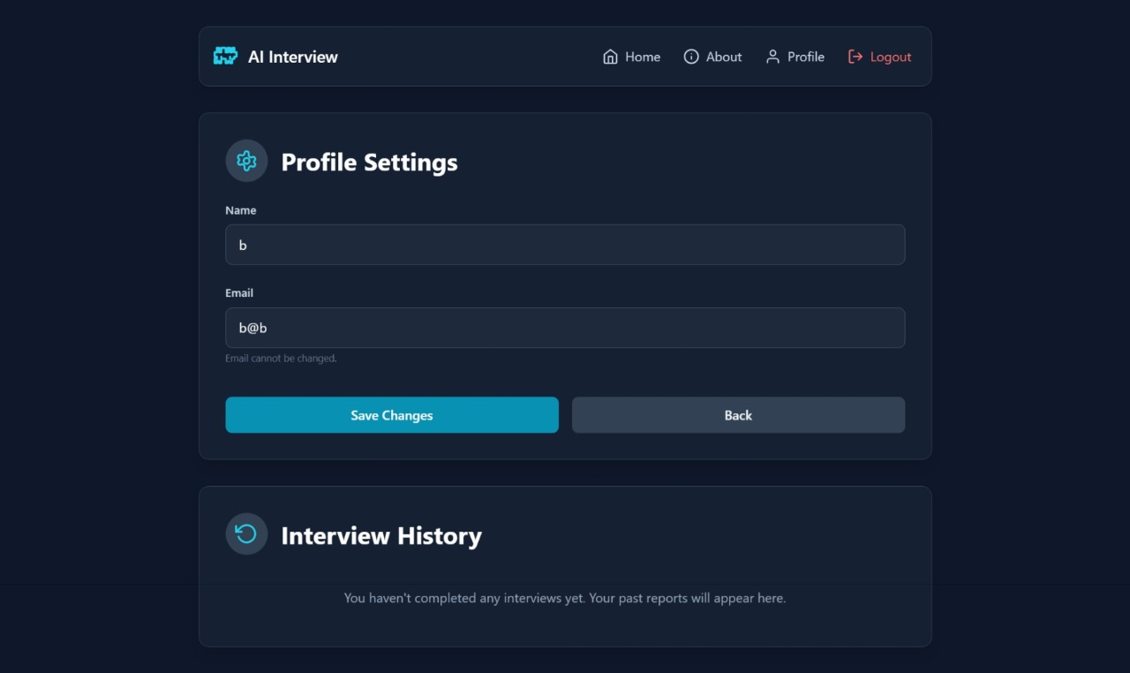
PROFILE PAGE

Slide 17
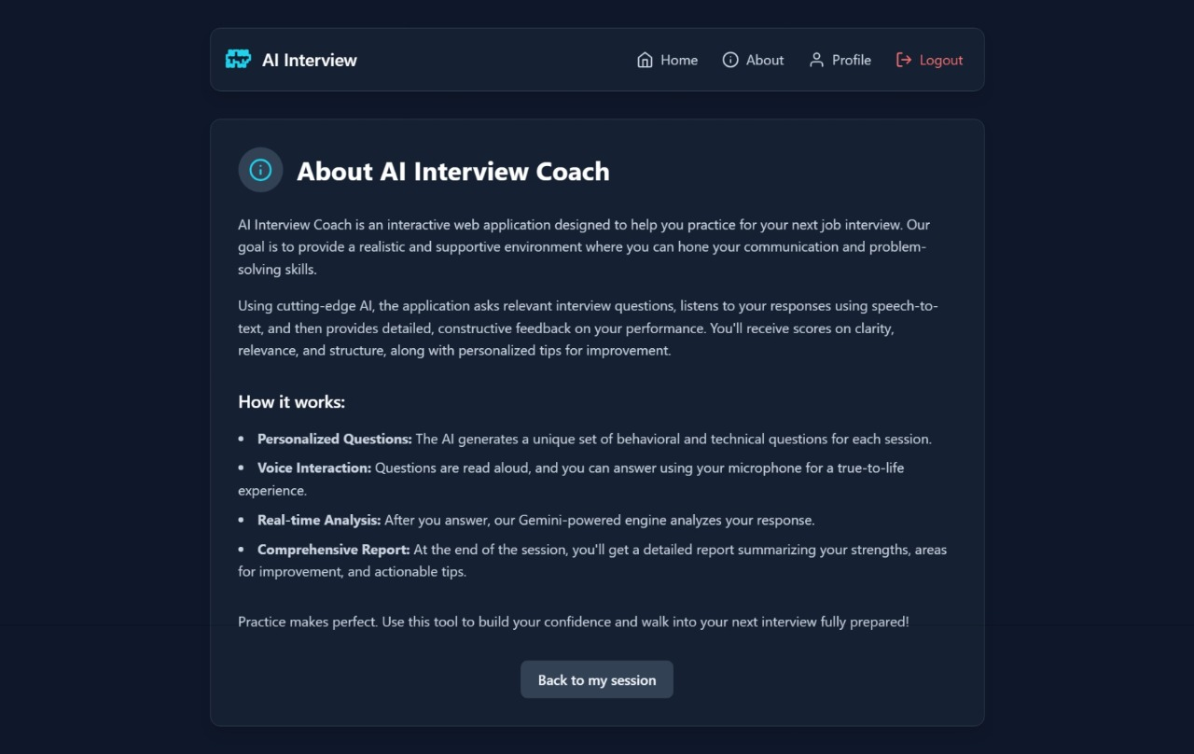
ABOUT PAGE

Slide 18
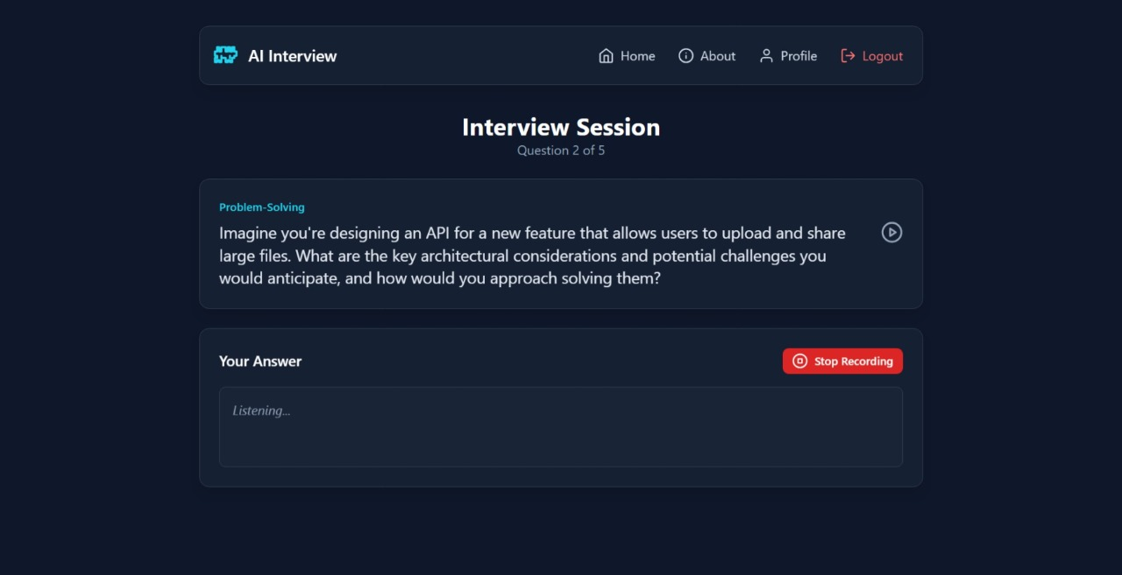
QUESTIONS

Slide 19
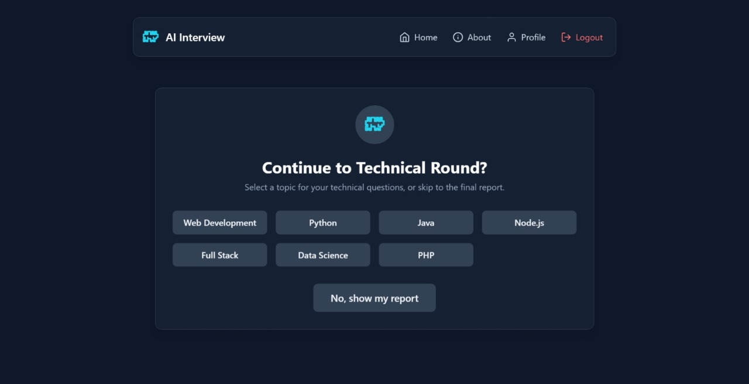
TECHNICAL QUESTIONS

Slide 20
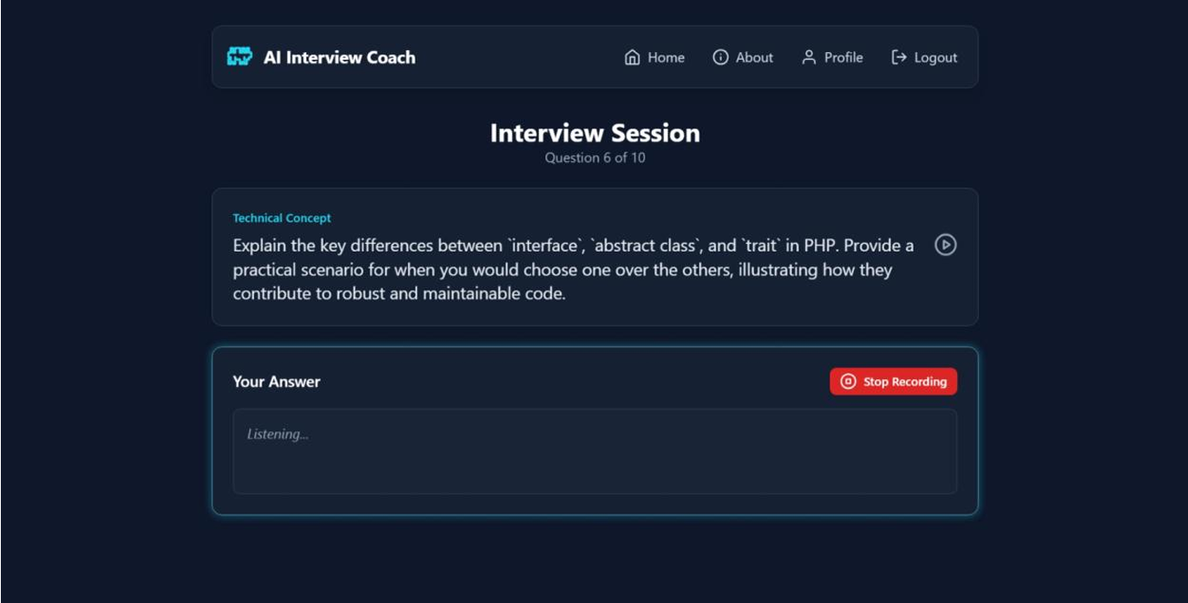
TECHNICAL QUESTIONS

Slide 21
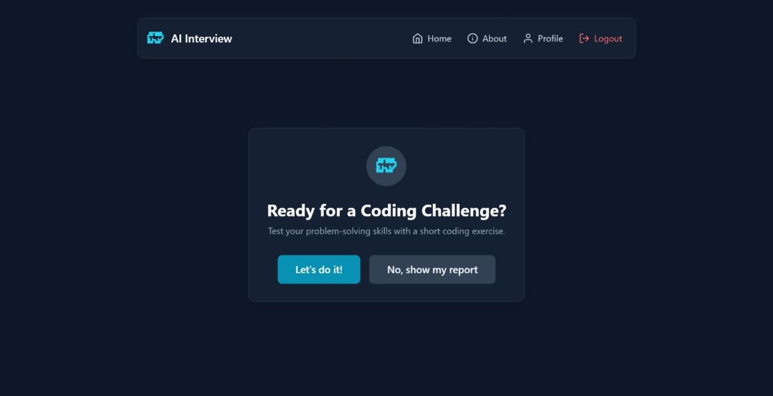
CODING QUESTIONS

Slide 22
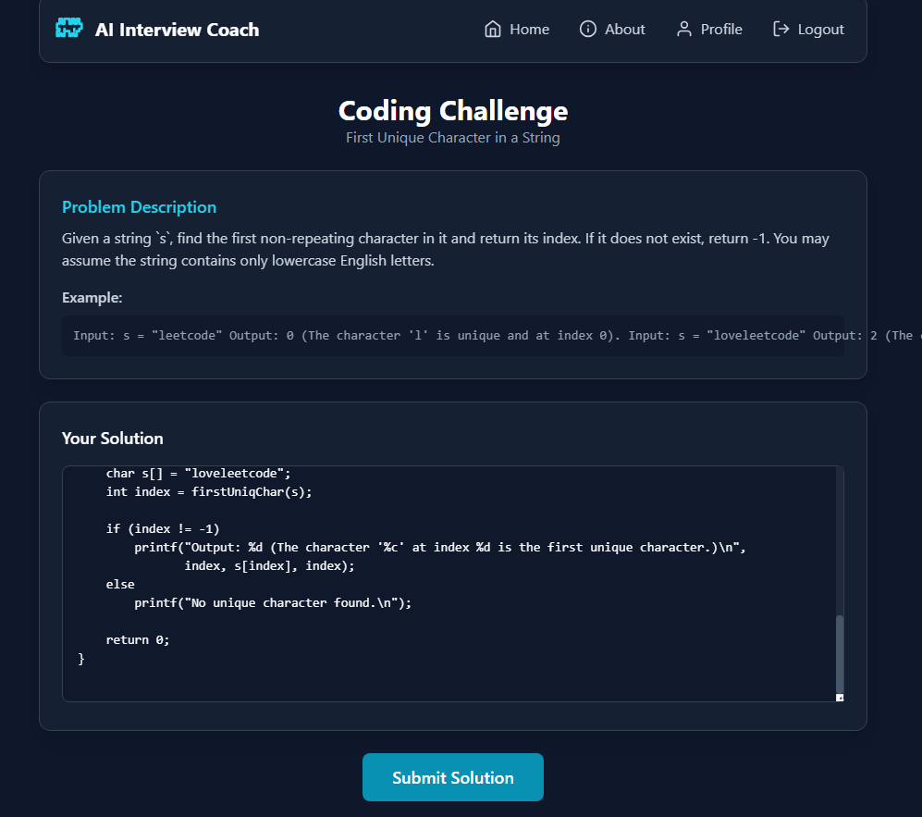
CODING QUESTIONS

Slide 23
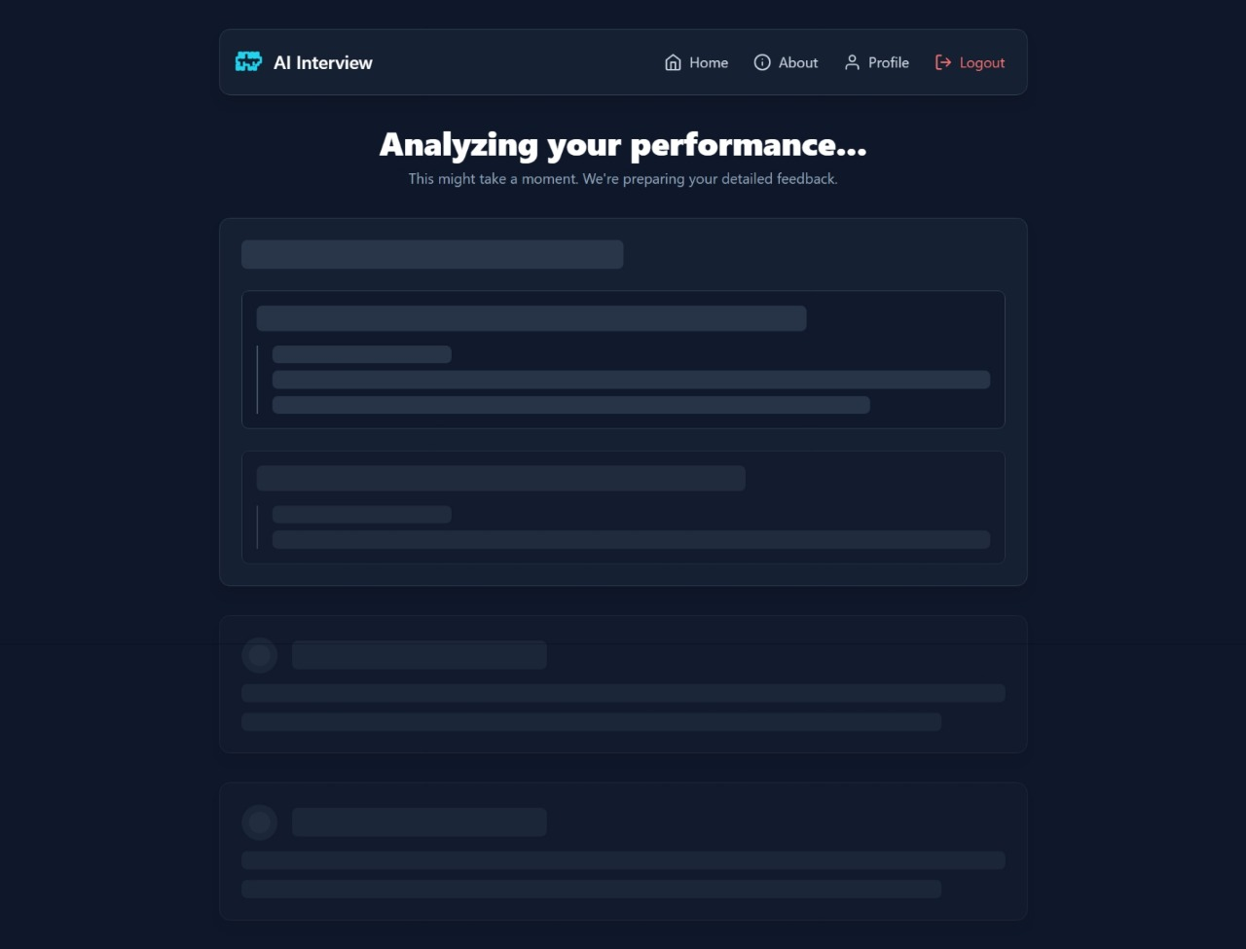
LODING STYLE

Slide 24
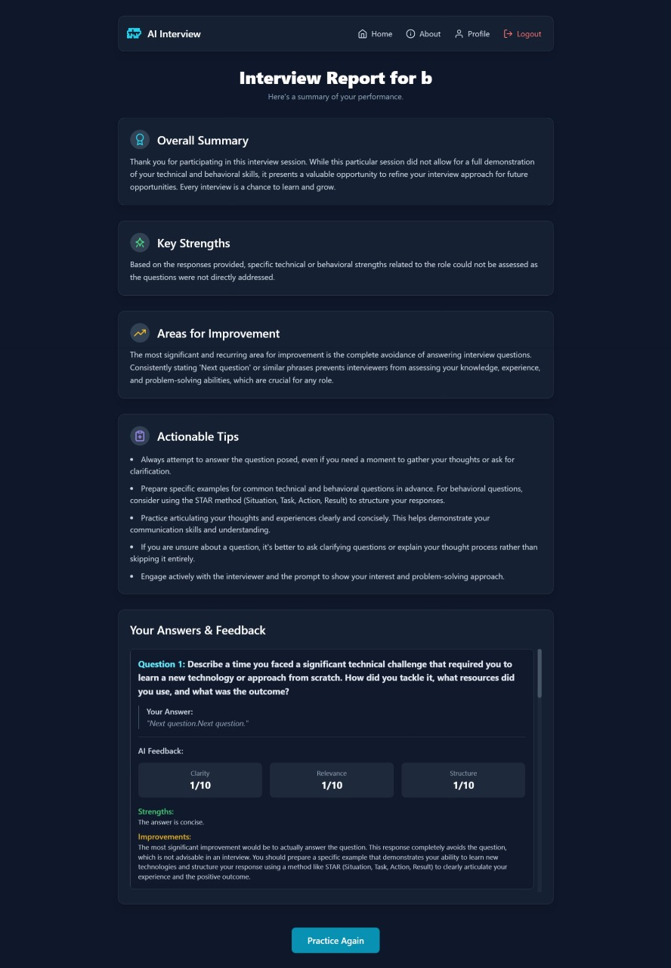
REPORT

Slide 25
Feedback

Slide 26


